Slide 1
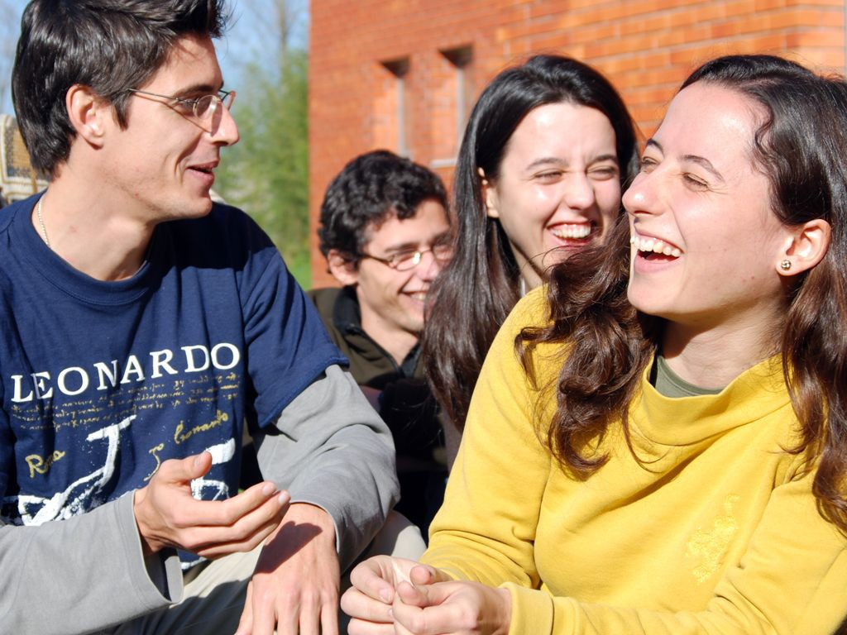
UNIVERSITY OF PORTO
Portugal

Slide 2
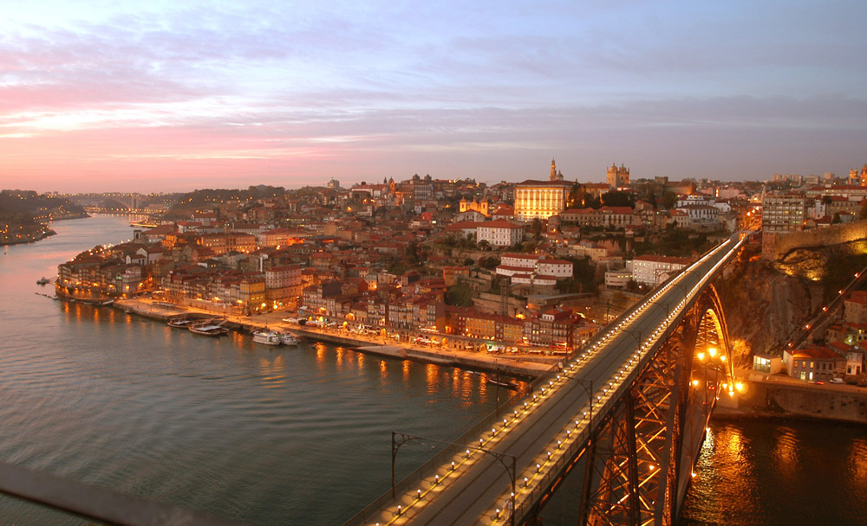
PORTO
one of the oldest cities of Europe and the second largest city of Portugal

Slide 3
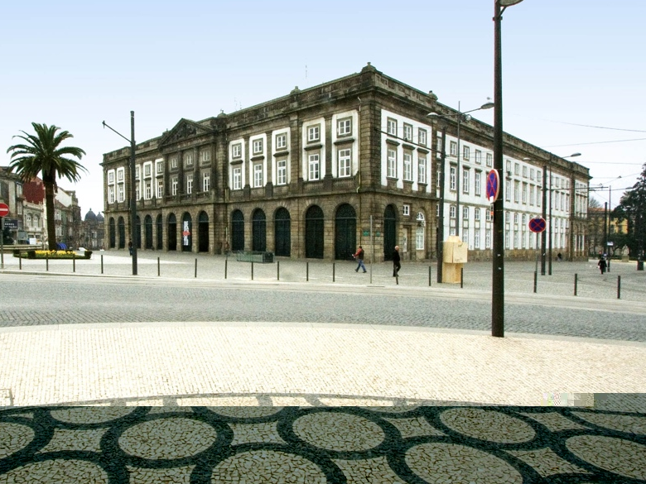
With origins dating back to the eighteenth century, the University of Porto is the largest and one of the oldest and most prestigious Higher Education Institutions in Portugal.

Slide 4
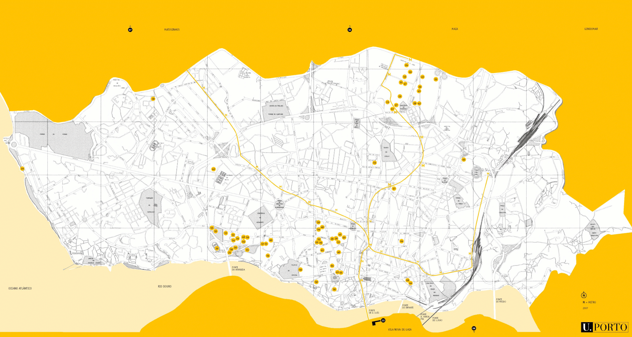
Pole 2
Pole 3
Pole 1
3 Campuses
14 Faculties
1 Business School

Slide 5
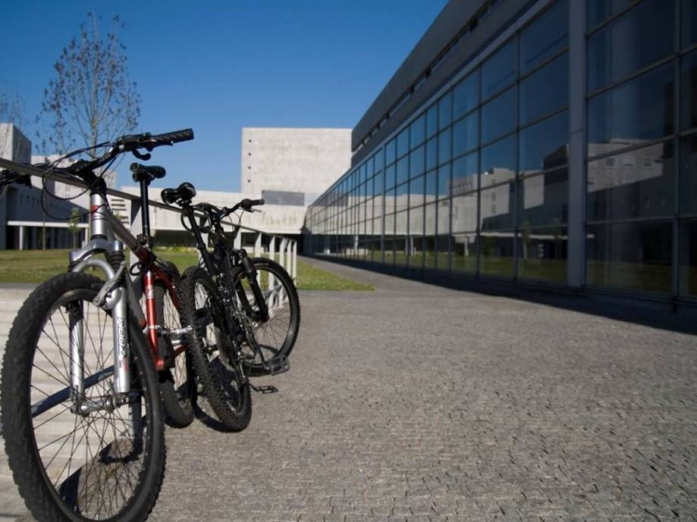
Infrastructures
11 canteens + 1 restaurant + 7 snack-bars + 1 grill
9 Halls of Residence
30 Libraries
12 Museums
E-Learning Café
Sports Centre
Wireless conection in all the University’s buildings

Slide 6
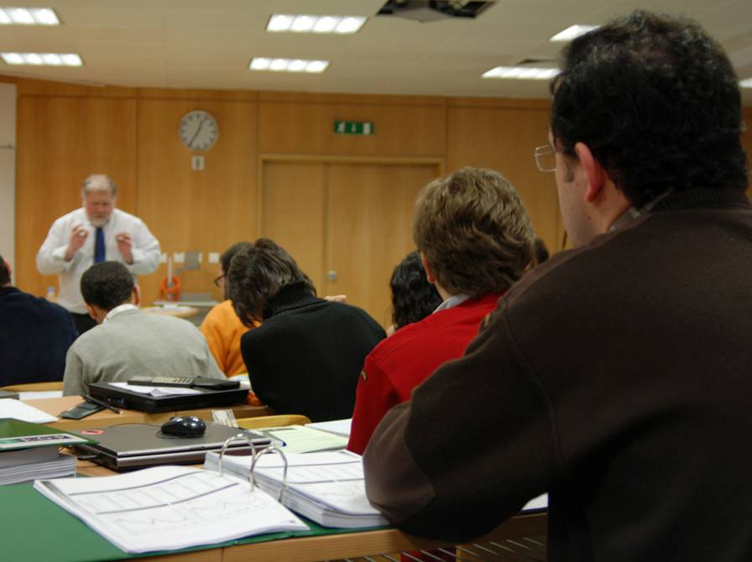
701 Training programmes
35 1st Cycle/Degree (BSc) courses
18 Integrated Masters (BSc + MSc) courses
135 2nd Cycle/Masters (MSc) courses
89 3rd Cycle/Doctorate (PhD) courses
399 Lifelong Education courses

Slide 7
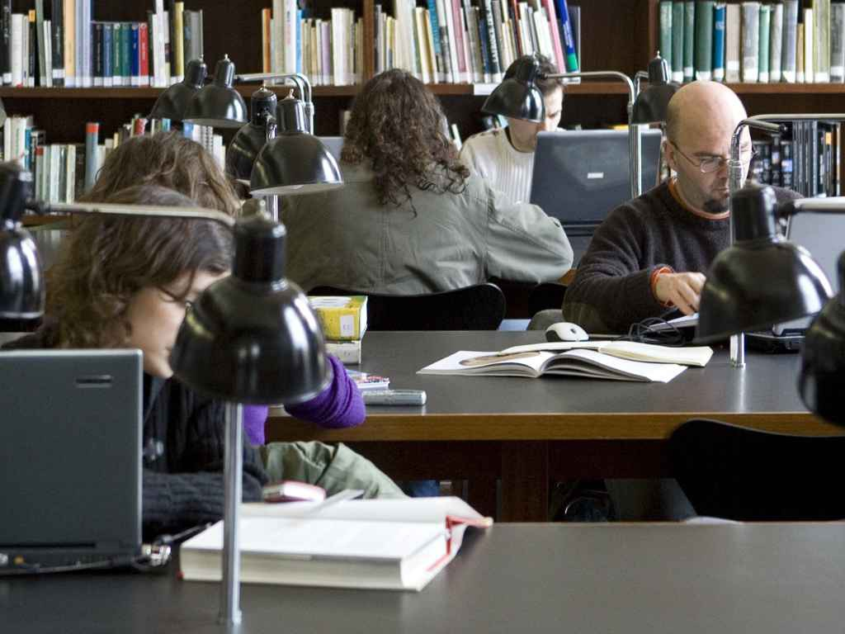
31.385 Students
9.697 1st Cycle/Degree students
12.783 Integrated Master
5.640 2nd Cycle/Master
2.923 3rd Cycle/Doctorate

Slide 8

International
Cooperation

Slide 9
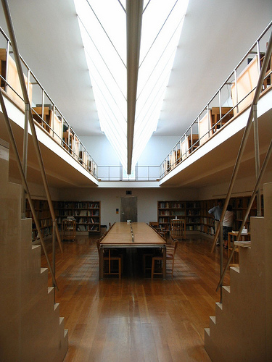
3,380 Foreign students in 2011 (10.89% of total)
1,474 On international mobility programmes
In 1st Cycle/Degrees
404 In 2nd Cycle/Masters
407 In 3rd Cycle/Doctorates
463 Researchers (including 139 Post-docs)
98 Nationalities

Slide 10
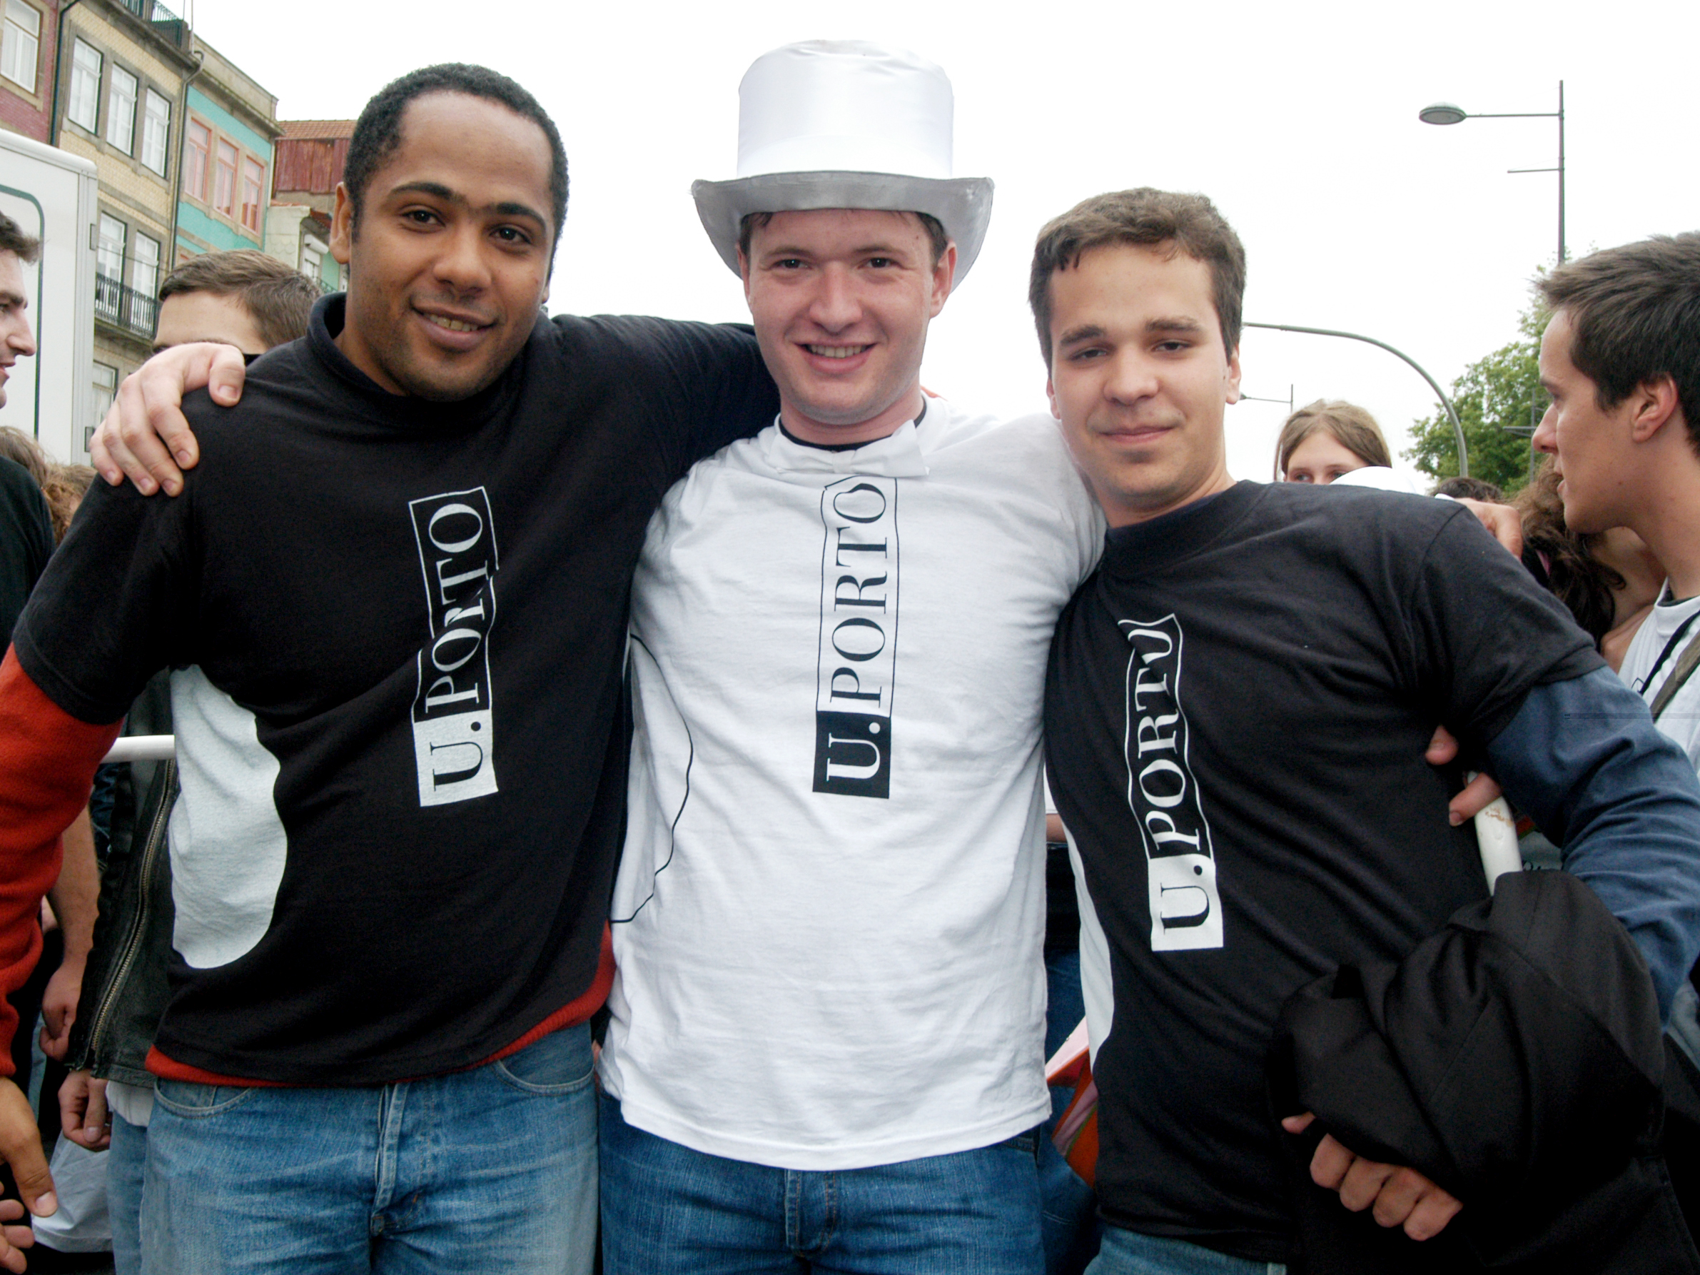
Foreign students by origin (2011)
287 Africa 1.339 Europe
256 Asia 4 Oceania
1.498 Americas

Slide 11
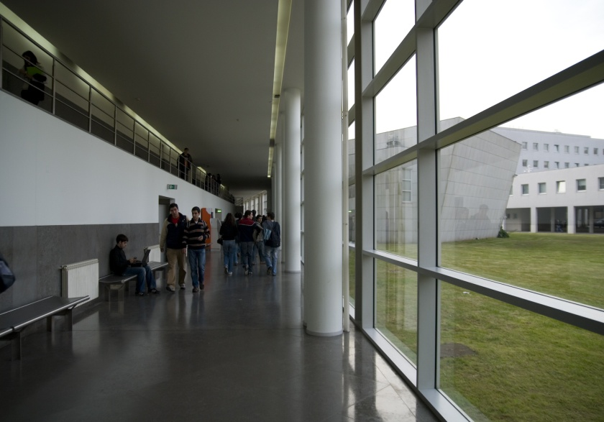
1442 agreements and partnerships with HEIs and Research Centres from 110 countries:
Erasmus Agr.: 494 Bilateral Agr.: 206
Inter. Projects: 742

Slide 12

Cooperation in Higher Education
Erasmus Mundus

Slide 13
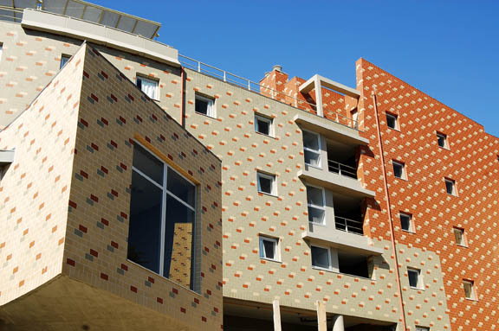
7 Projects coordinated by U.Porto
- Project MUNDUS ACP: ACP countries
- Project MUNDUS ACPII: ACP countries
- Project ANGLE: ACP countries
- Project EURO BRAZILIAN WINDOWS: Brazil
- Project EURO BRAZILIAN WINDOWS II: Brazil
- Project MUNDUS 17: Brazil, Paraguay and Uruguay
- Project BABEL: Brazil, Bolivia, Ecuador, Peru, Paraguay, Uruguay

Slide 14
17 Projects in which U.Porto is partner (1)
- ARCOIRIS: Argentina
coordinated by Politécnico de Torino (Italy)
- EUROTANGO: Argentina
coordinated by Universidad Politécnica de Valencia (Spain)
- EUROTANGO II: Argentina,
coordinated by Universidade Politécnica de Valência (Spain)
- LOT 18: México,
coordinated by University of Groningen (The Netherlands)
- LOT 20: Honduras, Guatemala, Nicaragua, El Salvador and Mexico,
coordinated by University of Groningen ( The Netherlands)
- COOPEN: Colombia, Costa Rica, Panama
coordinated by Universidade Politécnica de Valência (Spain)

Slide 15
17 Projects in which U.Porto is partner (2)
- MUNDUS LINDO: Bolivia, Peru, Ecuador, Paraguay, Chile, Brazil and Cuba
coordinated by the University of Valladolid (Spain)
- LOTUS: Cambodia, China, Indonesia, Myanmar, Thailand, Vietnam
coordinated by Ghent University (Belgium)
- LOTUS II: Cambodia, China, Indonesia, Myanmar, Thailand, Vietnam
coordinated by Ghent University (Belgium)
- LOTUS III: Cambodia, China, Indonesia, Myanmar, Thailand, Vietnam
coordinated by Ghent University (Belgium)
- TOSCA : Kazakhstan, Kyrgyzstan, Tajikistan, Turkmenistan, Uzbekistan
coordinated by Adam Mickiewicz University (Poland)
- TOSCA II: Kazakhstan, Kyrgyzstan, Tajikistan, Turkmenistan, Uzbekistan
coordinated by Adam Mickiewicz University (Poland)

Slide 16
17 Projects in which U.Porto is partner (3)
- ALFIHRI: Algeria, Morocco, Tunisia, Egypt, Libya
coordinated by the University of Deusto (Spain)
- GREEN IT: Algeria, Morocco, Tunisia, Egypt
coordinated by the University of Vigo (Spain)
- EMINENCE: Georgia, Armenia, Azerbaijan, Ukraine, Moldova, Belarus
coordinated by Adam Mickiewicz University (Poland)
- INDIA4EU II: India
coordinated by Politécnico de Torino (Italy)
-MOVER: Cambodia, China, Philippines, India, Indonesia, Laos, Malasia, Vietnam coordinated by the University of Murcia (Spain)

Slide 17
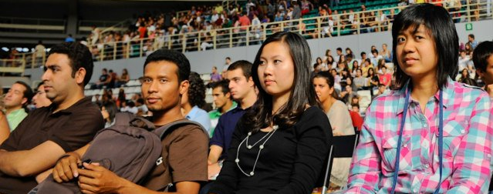
Support to Erasmus Mundus
As host institution, U.Porto provides full support to all the Erasmus Mundus mobility flows:
Visa issue (close contact with Consulates and Portuguese Immigration Office)
Preparation of LA (guidance regarding courses selection)
Accommodation (hall of residence or private with special conditions)
Pre-opening of bank account
Close monitoring

Slide 18
Support to Erasmus Mundus
Support on arrival (airport pick-up, support in administrative issues such as immigration office, bank, residence, faculty, language courses)
Welcoming meeting with practical information
Welcoming session especially to E. Mundus
Welcoming session to all foreign students
Cultural and integration activities promoted by the International Office and ESN
Erasmus Mundus buddy-system

Slide 19
www.up.pt
Thank you!
http://emundus.up.pt

